Slide 1
Data Warehousing
Data sources often store only current data, not historical data
Large organizations have a complex internal organization structure and therefore different data may be present in different locations or on different operational systems or under different schemas.
Corporate decision making requires a unified view of all organizational data, including historical data.
Data may also be purchased externally.
A data warehouse is a repository (archive) of information gathered from multiple sources, stored under a unified schema, at a single site. Thus they provide the user a single uniform interface to data.
Greatly simplifies querying, permits study of historical trends
Once gathered, the data are stored for a long time, permitting access to historical data
Provides the user a single consolidated interface to data, making decision support queries easier to write.
Shifts decision support query load away from transaction processing systems

Slide 2
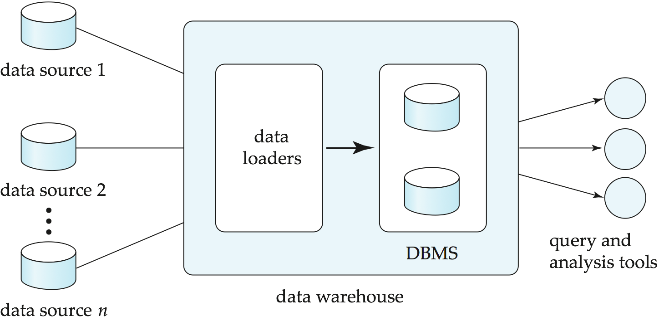
Data Warehousing

Slide 3
Multidimensional Data and Warehouse Schemas
Data warehouse typically have schemas that are designed for data analysis, using tools such as OLAP. Thus, the data are usually multidimensional data, with dimension attributes and measure attributes.
Data in warehouses can usually be divided into
Fact tables, which are large
E.g, sales(item_id, store_id, customer_id, date, number, price)
Dimension tables, which are relatively small
Store extra information about stores, items, etc.
Attributes of fact tables can be usually viewed as
Measure attributes
measure some value, and can be aggregated upon
e.g., the attributes number or price of the sales relation
Dimension attributes
dimensions on which measure attributes are grouped and viewed
e.g., attributes item_id, date, location and customer of the sales rela.
Usually small ids that are foreign keys to dimension tables

Slide 4
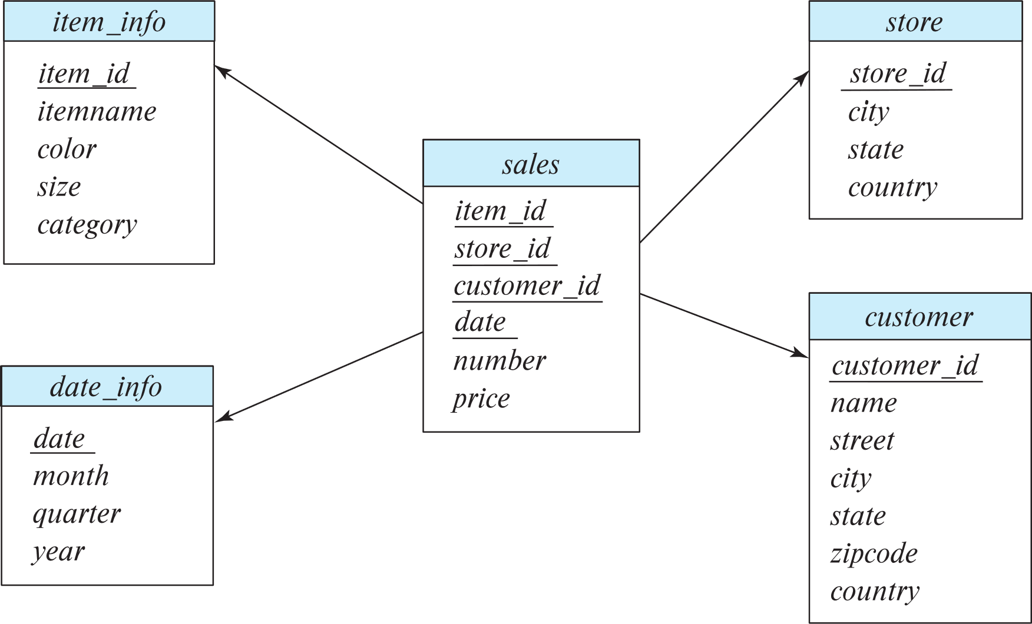
Data Warehouse Schema

Slide 5
Multidimensional Data and Warehouse Schemas
Resultant schema is called a star schema. A schema, with a fact table, multiple dimension tables and foreign keys from the fact table to dimension tables, is called a star schema.
More complicated schema structures
Snowflake schema: multiple levels of dimension tables
Constellation schema: May have multiple fact tables
Typically
fact table joined with dimension tables and then
group-by on dimension table attributes, and then
aggregation on measure attributes of fact table

Slide 6
Conceptual Modeling of Data Warehouses
Modeling data warehouses: dimensions and measures
Star schema: A fact table in the middle connected to a set of dimension tables
Snowflake schema: A refinement of star schema where some dimensional hierarchy is normalized into a set of smaller dimension tables, forming a shape similar to snowflake
Fact constellations: Multiple fact tables share dimension tables, viewed as a collection of stars, therefore called galaxy schema or fact constellation

Slide 7
Example of Star Schema
time
time_key
day
day_of_the_week
month
quarter
year
item
item_key
item_name
brand
type
supplier_type
Sales Fact Table
time_key
item_key
branch_key
branch
location
location_key
branch_key
branch_name
branch_type
location_key
street
city
province_or_street
country
units_sold
dollars_sold
avg_sales
Measures

Slide 8
Example of Snowflake Schema
time
item
time_key
day
day_of_the_week
month
quarter
year
item_key
item_name
brand
type
supplier_key
supplier
Sales Fact Table
supplier_key
supplier_type
time_key
item_key
branch_key
branch
location
location_key
location_key
street
city_key
branch_key
branch_name
branch_type
units_sold
city
dollars_sold
city_key
city
province_or_street
country
avg_sales
Measures

Slide 9
Example of Fact Constellation
time
time_key
day
day_of_the_week
month
quarter
year
item
Shipping Fact Table
item_key
item_name
brand
type
supplier_type
Sales Fact Table
time_key
time_key
item_key
shipper_key
item_key
branch_key
from_location
branch
location_key
location
to_location
branch_key
branch_name
branch_type
units_sold
location_key
street
city
province_or_street
country
dollars_cost
dollars_sold
units_shipped
avg_sales
shipper
Measures
shipper_key
shipper_name
location_key
shipper_type

Slide 10
Data Analysis and OLAP
Data analysis often involves looking for patterns that arise when data values are grouped in “interesting” ways. In a retail business, we might group sales by product, the date or month of the sale, the color or size of the product, or the profile (such as age group and gender) of the customer who bought the product .
Online Analytical Processing (OLAP)
Interactive analysis of data, allowing data to be summarized and viewed in different ways in an online fashion (with negligible delay)
Consider an application where a shop wants to find out what kinds of clothes are popular. Consider the following relation sales with the schema:
sales (item_name, color, cloths_size, quentity)
item_name can take the values (skirt, dress, shirt, pant)
color can take the values (dark, pastel, white)
cloths_size can take the values (small, medium, large)
Given a relation for data analysis, some of its attributes can be identified as measure attributes and some (or all) the other attributes of the relation are identified as dimension attributes.

Slide 11
Data Analysis and OLAP
Measure attributes
measure some value and can be aggregated upon
e.g. the attribute quantity of the sales relation (measure the number of sold item)
Dimension attributes
define the dimensions on which measure attributes (or aggregates thereof) are viewed
e.g. the attributes item_name, color, and cloths_size of the sales relation.
Additional dimension may be time and sales location and additional measures may be monetary value
Data that can be modeled as dimension attributes and measure attributes are called multidimensional data.

Slide 12
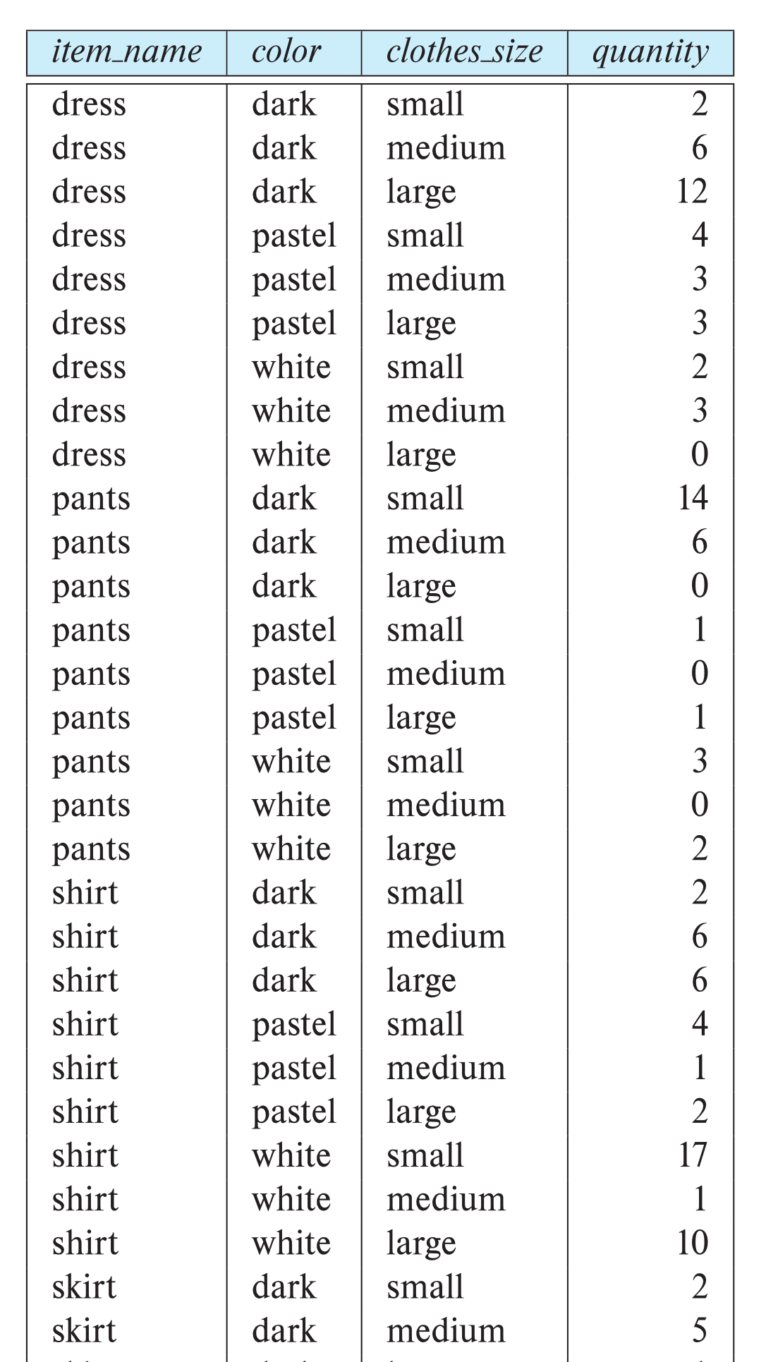
Example sales relation
...
...
...
...
...
...
...
...

Slide 13
Cross Tabulation of sales by item_name and color
The table above is an example of a cross-tabulation (cross-tab), also referred to as a pivot-table. In general, a cross-tab is a table derived from a relation, where
Values for one of the dimension attributes form the row headers
Values for another dimension attribute form the column headers
Other dimension attributes are listed on top
Values in individual cells are (aggregates of) the values of the dimension attributes that specify the cell.
Most of the cross-tab also has an extra column and row showing the totals of the cell in the row/column

Slide 14
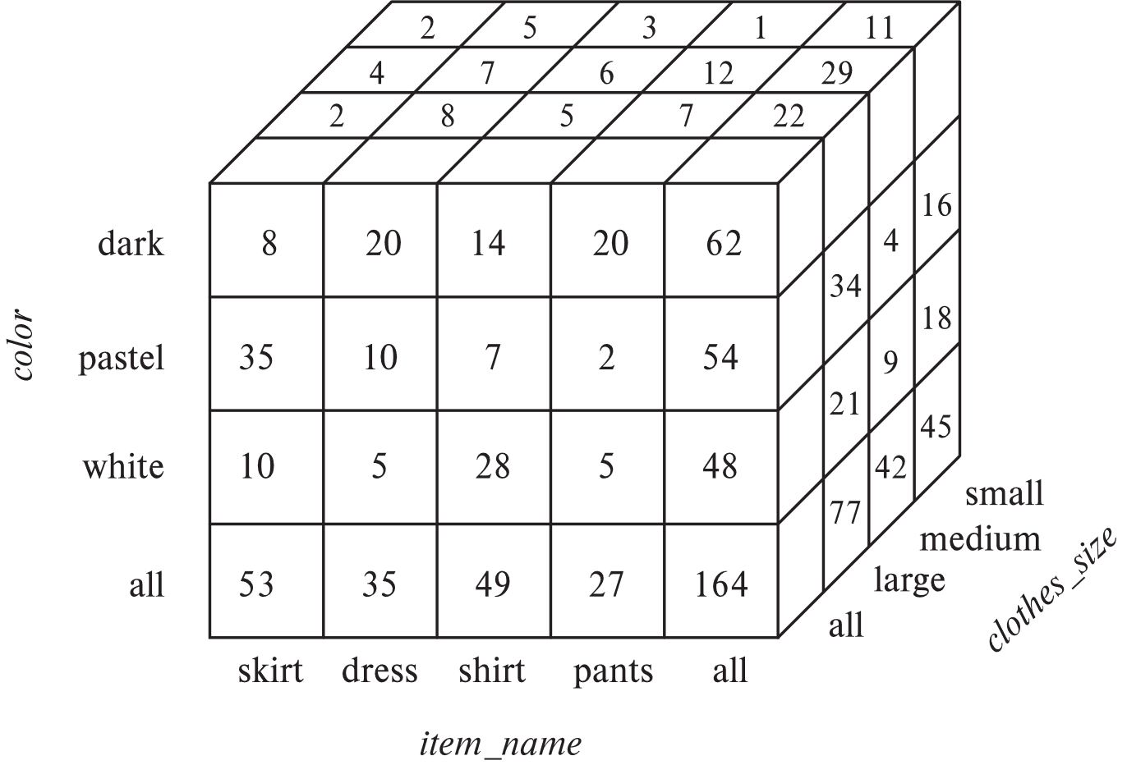
Data Cube
A data cube is a multidimensional generalization of a cross-tab
Can have n dimensions; we show 3 below
Cross-tabs can be used as views on a data cube

Slide 15
Data Cube
Each cell in the data cube contains a value, just as in a cross-tab. The value contained in a cell is shown on one of the faces of the cell; other faces of the cell are shown blank if they are visible. All cells contains values, even if they are not visible.
The value for a dimension may be all, in which case the cell contains a summary over all the values of that dimension, as in the case of cross-tab.
The number of different ways in which the tuples can be grouped for aggregation can be large. In fact, for a table with n dimensions, aggregation can be performed with grouping on each of the 2^{n} subsets of the n dimensions.

Slide 16
Online Analytical Processing Operations
An online analytical processing or OLAP system is an interactive system that permits an analyst to view different summaries of multidimensional data.
The word online indicates that an analyst must be able to request new summaries and get responses online, within few seconds and should not be forced to wait for a long time to see the result of the query.
With an OLAP system, a data analyst can look at different cross-tabs on the same data by interactively selecting the attributes in the cross-tabs.
For instance, the analyst may wish to see a cross-tab on
item-name and size or color and size or color and item-name.
Pivoting: changing the dimensions used in a cross-tab
E.g., moving colors to column names
Slicing: creating a cross-tab for fixed values only
E.g., a cross-tab on item-name and color for a fixed value of size (say large), instead of the sum across all sizes. It can be thought of as viewing a slice of a data cube
Sometimes called dicing, particularly when values for multiple dimensions are fixed.

Slide 17
Online Analytical Processing Operations
When a cross-tab is used to view a multidimensional cube, the values of dimension attributes that are not part of the cross-tab are shown above the cross-tab. The value of such an attribute can be all, indicating that the data in the cross-tab are a summary over all values of the attribute. Slicing/dicing simply consists of selecting specific values for these attributes, which are then displayed on top of the cross-tab.
Rollup: OLAP system permits users to view data at any desired level of granularity. The operation of moving from finer-granularity data to a coarser granularity (by means of aggregation) is called a rollup.
E.g., aggregating away an attribute
E.g., moving from aggregates by day to aggregates by month or year
Drill down: The opposite operation - that of moving from coarser-granularity data to finer-granularity data
Clearly, finer-granularity data can not be generated from coarse-granularity data; they must be generated either from the original data or from even finer-granularity summary data.

Slide 18
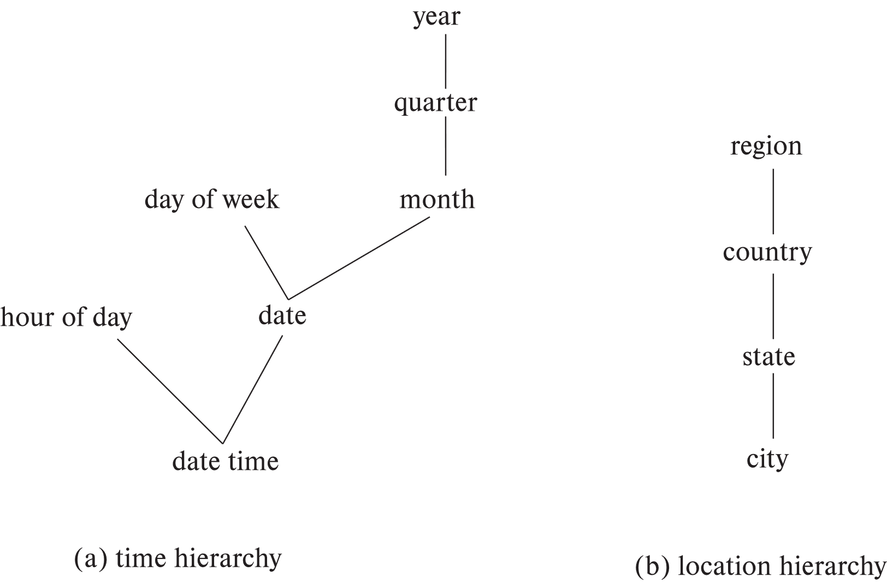
Hierarchies on Dimensions
Hierarchy on dimension attributes: lets dimensions be viewed at different levels of detail
E.g., the dimension datetime can be used to aggregate by hour of day, date, day of week, month, quarter or year
Cloths
Category
Itemname
c) Clothe Hierarchy

Slide 19
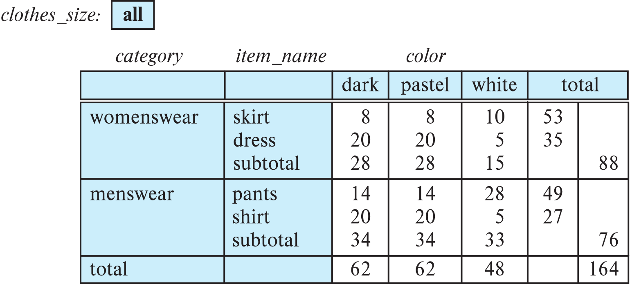
Cross Tabulation With Hierarchy
Cross-tabs can be easily extended to deal with hierarchies
Can drill down or roll up on a hierarchy
E.g. hierarchy: item_name → category

Slide 20
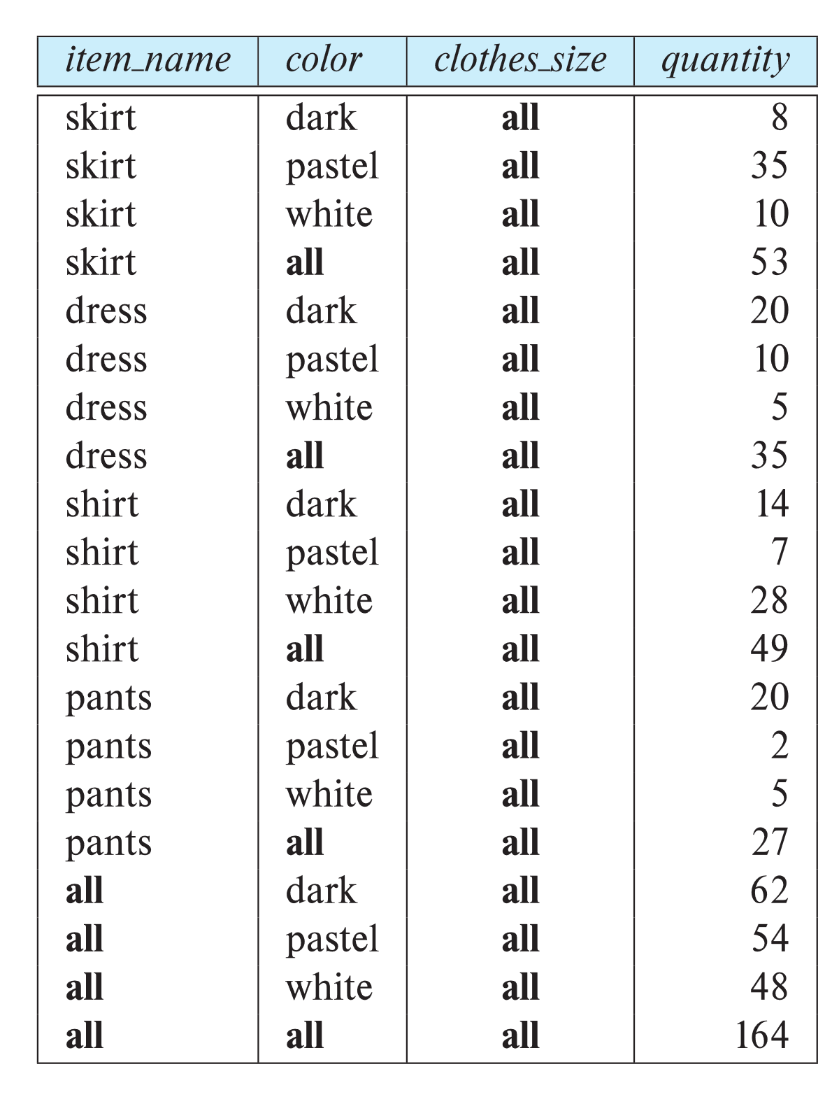
Relational Representation of Cross-tabs
A cross-tab is different from relational tables usually stored in databases, since the number of columns in the cross-tab depends on the actual data. A change in the data value may results in adding more columns.
Cross-tabs can be represented as relations
We use the value all to represent aggregates/sub-totals.
The SQL standard actually uses null values in place of all but can cause confusion with regular null values.

Slide 21
Olap in SQL

Slide 22
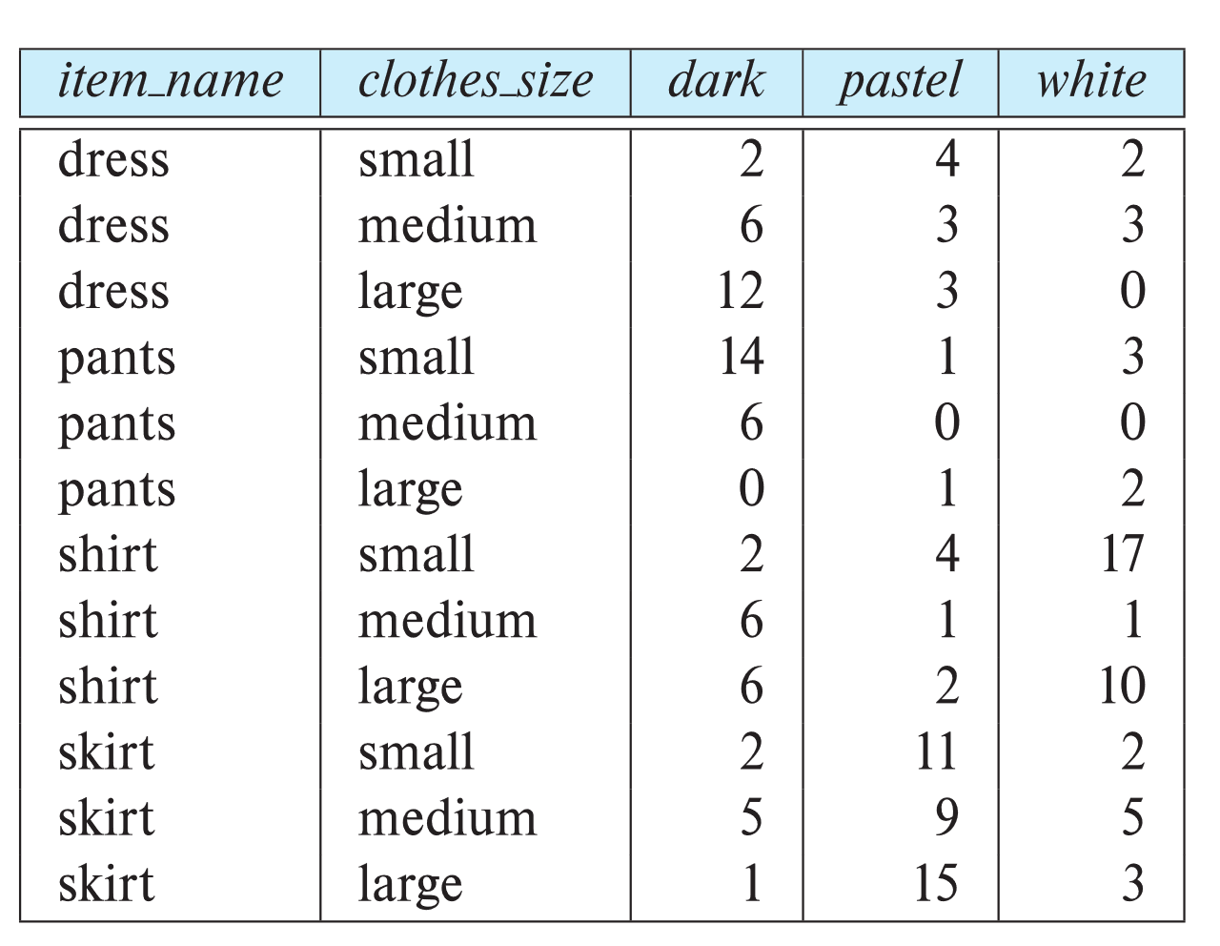
Pivot Operation
Microsoft SQL Server and Oracle, support a pivot clause that allows creation of cross-tabs.
select * from sales pivot ( sum(quantity) for color in ('dark','pastel','white') ) order by item name;

Slide 23
Cube Operation
SQL supports generalizations of the group by construct to perform the cube and rollup operations.
The cube operation computes union of group by’s on every subset of the specified attributes
E.g., consider the query
select item_name, color, size, sum(number) from sales group by cube(item_name, color, size)
This computes the union of eight different groupings of the sales relation:
{ (item_name, color, size), (item_name, color), (item_name, size), (color, size), (item_name), (color), (size), ( ) }
where ( ) denotes an empty group by list.
For each grouping, the result contains the null value for attributes not present in the grouping.
Data cube relations are often very large. The cube query above, with 3 possible colors, 4 possible item names, and 3 sizes and with summary values has 80 tuples.
Notes:
23

Slide 24
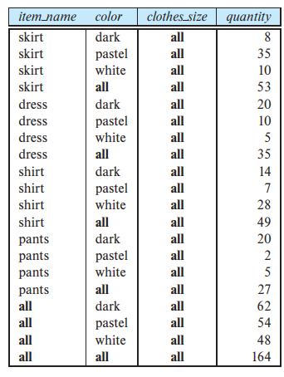
Online Analytical Processing Operations
Relational representation of cross-tab that we saw earlier, but with null in place of all, can be computed by
select item_name, color, sum(number) from sales group by cube(item_name, color)
The relation of right side is generated by doing a group by cube on item name and color, with an extra column specified in the select clause showing all for clothes_size.
Notes:
24

Slide 25
Online Analytical Processing Operations
The function grouping() can be applied on an attribute
Returns 1 if the value is a null value representing all, and returns 0 in all other cases.
select case when grouping(item_name) = 1 then 'all’ else item_name end as item_name, case when grouping(color) = 1 then 'all’ else color end as color, 'all' as clothes_size, sum(quantity) as quantity from sales group by cube(item_name, color);
Can use the function decode() in the select clause to replace such nulls by a value such as all
E.g., replace item_name in first query by decode( grouping(item_name), 1, ‘all’, item_name)
Notes:
25

Slide 26
Extended Aggregation (Cont.)
The rollup construct is the same as the cube construct except that rollup generates fewer group by queries. The rollup construct generates union on every prefix of specified list of attributes
E.g.
select item_name, color, size, sum(number) from sales group by rollup(item_name, color, size)
Generates union of four groupings:
{ (item_name, color, size), (item_name, color), (item_name), ( ) }
Rollup can be used to generate aggregates at multiple levels of a hierarchy.
E.g., suppose table itemcategory(item_name, category) gives the category of each item. Then
select category, item_name, sum(number) from sales, itemcategory where sales.item_name = itemcategory.item_name group by rollup(category, item_name)
would give a hierarchical summary by item_name and by category.
Notes:
26

Slide 27
Extended Aggregation (Cont.)
Multiple rollups and cubes can be used in a single group by clause
Each generates set of group by lists, cross product of sets gives overall set of group by lists
E.g.,
select item_name, color, size, sum(number) from sales group by rollup(item_name), rollup(color, size)
generates the groupings
{item_name, ()} X {(color, size), (color), ()}
= { (item_name, color, size), (item_name, color), (item_name), (color, size), (color), ( ) }
Notes:
27

Slide 28
Extended Aggregation (Cont.)
Neither the rollup nor the cube clause gives complete control on the groupings that are generated.
For instance, we cannot use them to specify that we want only groupings {(color, clothes_size), (clothes_size, item name)}. Such restricted groupings can be generated by using the grouping sets construct, in which one can specify the specific list of groupings to be used.
To obtain only groupings {(color, clothes_size), (clothes_size, item_name)}, we would write:
select item_name, color, clothes_size, sum(quantity) from sales group by grouping sets ((color, clothes_size), (clothes_size, item_name));
Notes:
28

Slide 29
OLAP Implementation (Cont.)
Early OLAP systems precomputed all possible aggregates in order to provide online response
Space and time requirements for doing so can be very high
2^{n} combinations of group by
It suffices to precompute some aggregates, and compute others on demand from one of the precomputed aggregates
Can compute aggregate on (item_name, color) from an aggregate on (item_name, color, size)
For all but a few “non-decomposable” aggregates such as median
is cheaper than computing it from scratch
Several optimizations available for computing multiple aggregates
Can compute aggregate on (item_name, color) from an aggregate on (item_name, color, size)
Can compute aggregates on (item_name, color, size), (item_name, color) and (item_name) using a single sorting of the base data

